Slide 1
Competitive Study
Insurance Database

Slide 2
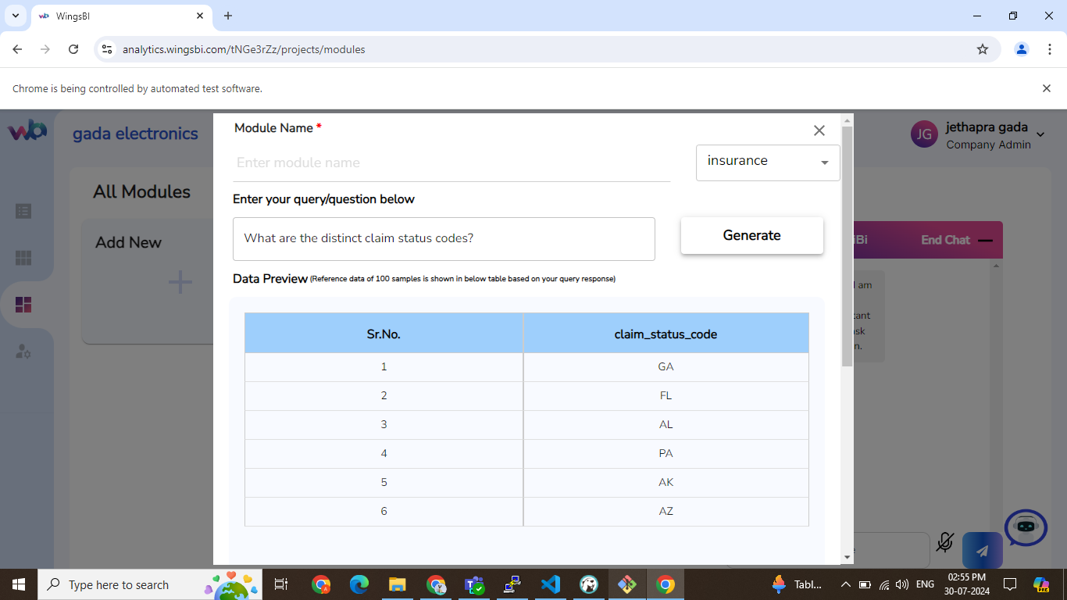
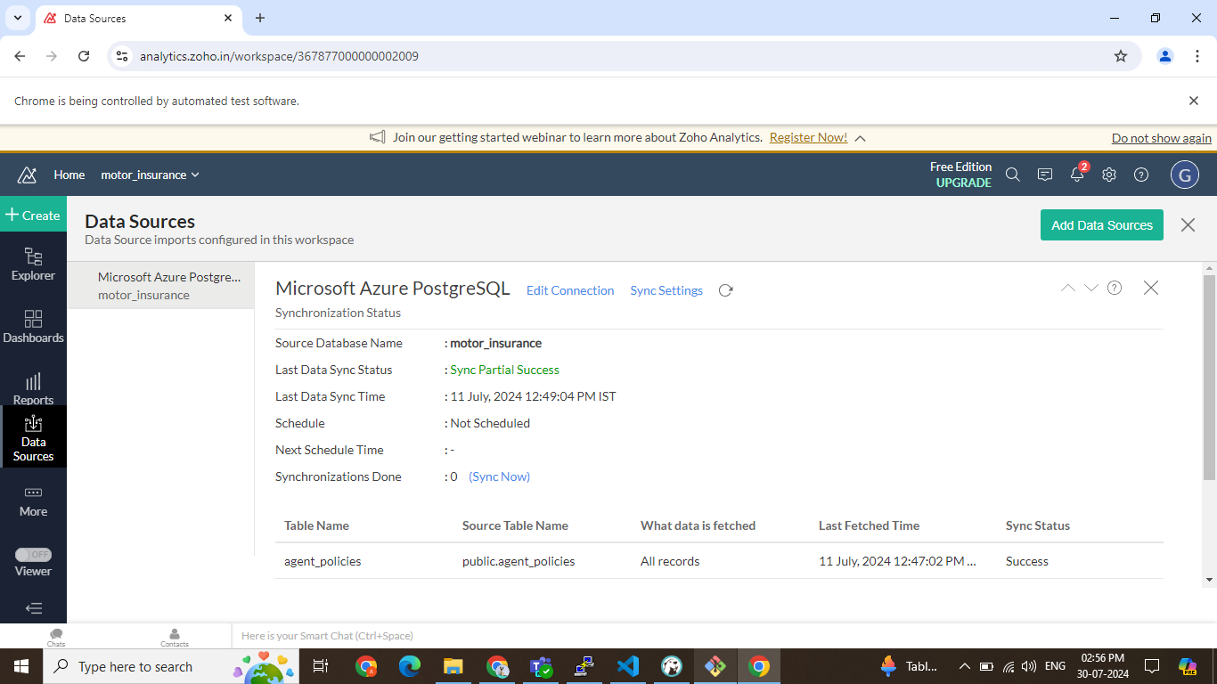
Q.1. What are the distinct claim status codes?
Wings
Zoho
Similarity: 68.24%

Slide 3
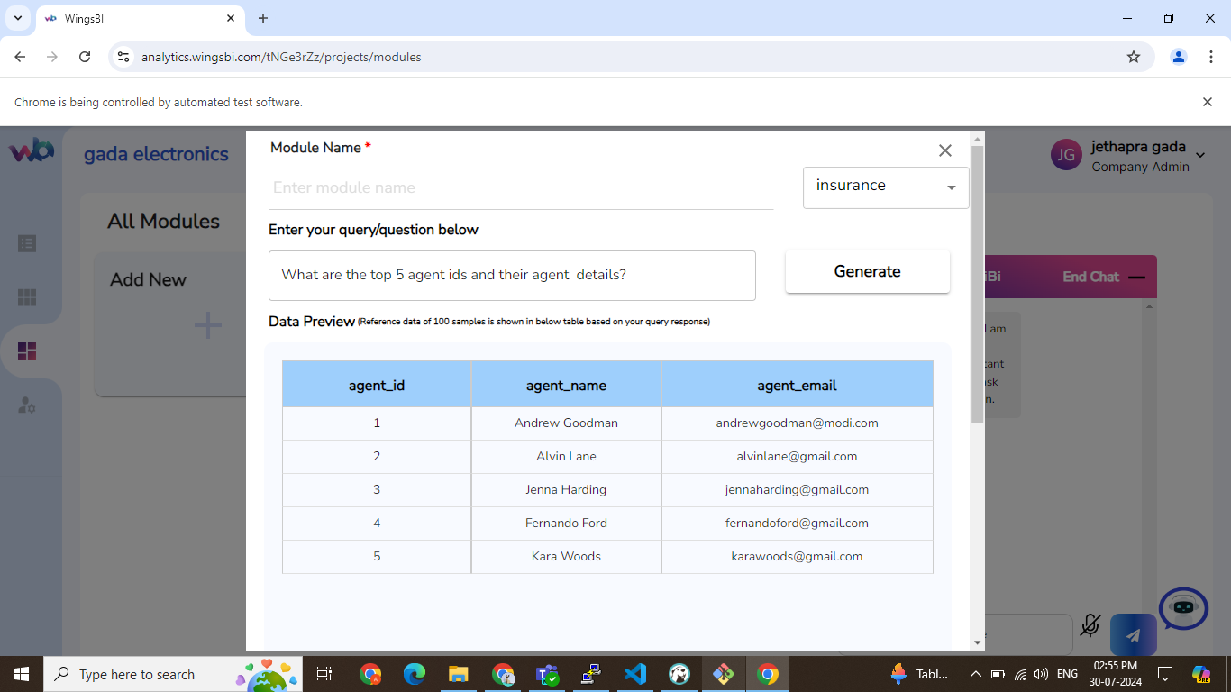
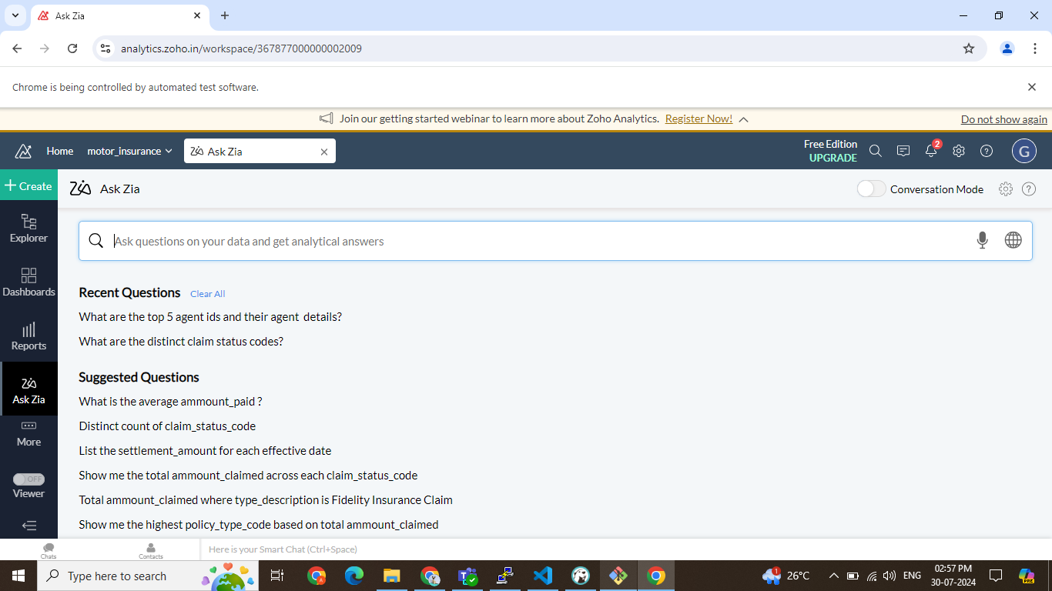
Q.2. What are the top 5 agent ids and their agent details?
Wings
Zoho
Similarity: 66.91%

